Slide 1

Lab2: Regression Study of the Spread of Covid-19
SECTION: 203.7 Team: 3
George Jiang
Ramon Jimenez
Sudhrity Mondal

Slide 2
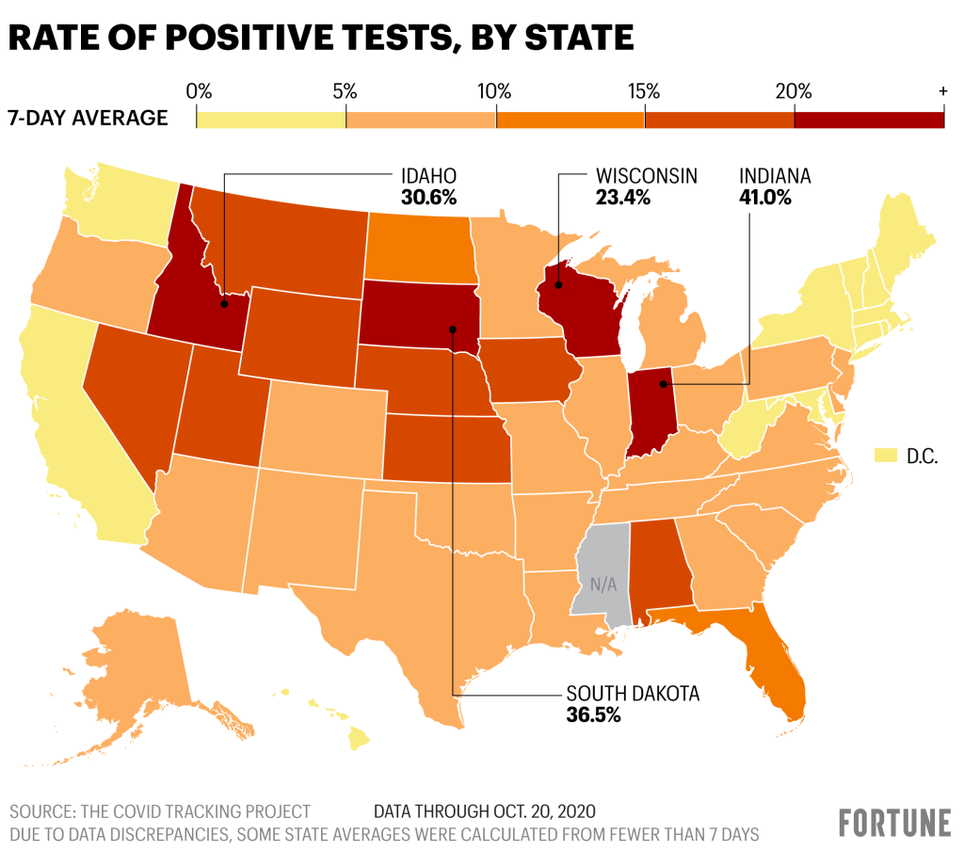
Approach
Identify Research Question
Causal Theory
Perform Exploratory Data Analysis
Identify Dependent & Independent Variables
Models
Base, Enhanced, All-Inclusive Models
Limitations of Model
Validate 6 CLM Assumptions
Omitted Variables
Regression Analysis
Conclusion

Slide 3
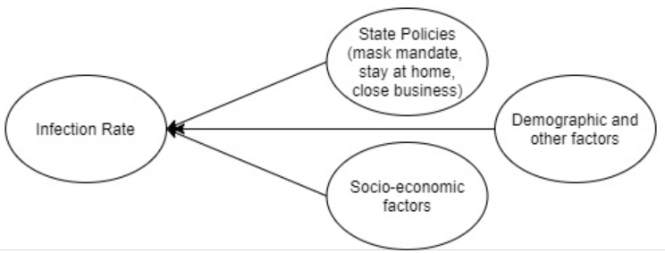
Data, Theory & Research Question
Data Source & Contents:
covid-19.xlsx
Data related to spread of the disease
Data related to state-level policy responses
State characteristics and demographics
Research Question:
What is the effect size of state level public health policy decisions on the rate of COVID-19 infection after taking into account for the variations across different states like population density, poverty rate and population under risk of serious illnesses?
Causal Theory:
All variables (in dataset) : State policies, health, social-economic factors, population factors, age, demography, …
All variables (not in dataset) : (to be added)
Omitted variables: Baseline infection rate (rate before policy), political bias and beliefs

Slide 4
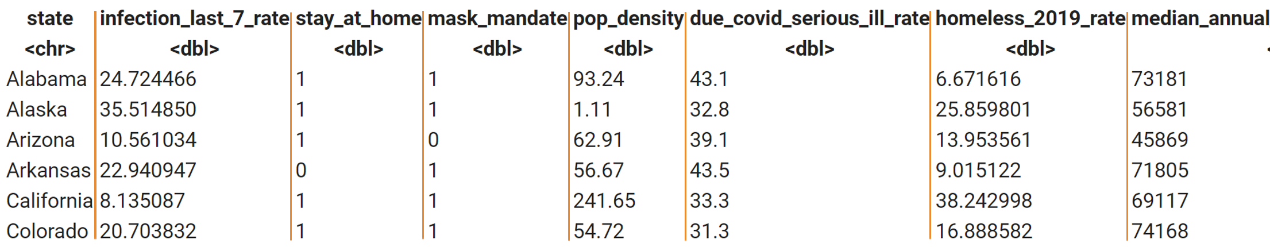
EDA Process
Steps:
1. Checked for outlier and incorrect data
Removed incorrect data
Log transformation skewed data to reduce the impact of outlier
2. Converted state policy to binary variables
3. Converted all numbers into a percentage to account for population difference between states
4. Use Pairs and correlation to filter out best variables and its transformation to use for the casual theory
income

Slide 5
Models & Feature Selection
Model 1 (Key Explanatory Variables: State Policies):
Stay at Home + Mask Mandate
Model 2 (Key Explanatory Variables and Other Covarying Causes):
Stay at Home + Mask Mandate + High risk Population % (Health & Age) + Pop Density + Homeless Rate+ Median Annual Household Income
Model 3 (Overfit with Additional Covariates):
Stay at Home + Mask Mandate + High Risk Population % (Health & Age) + Pop Density + Homeless Rate+ Median Annual Household Income + Poverty Rate + Ethnicity Population % + Age Population %

Slide 6
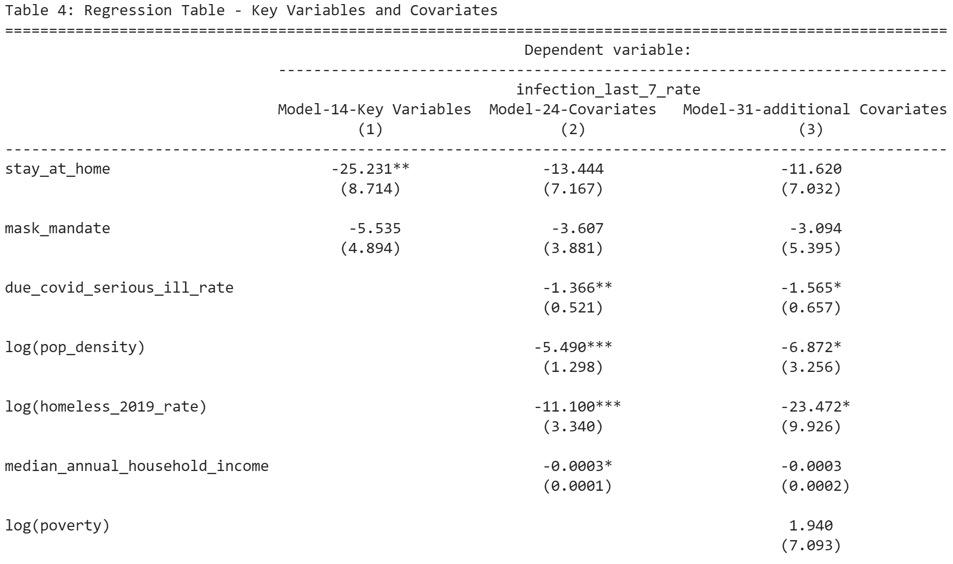
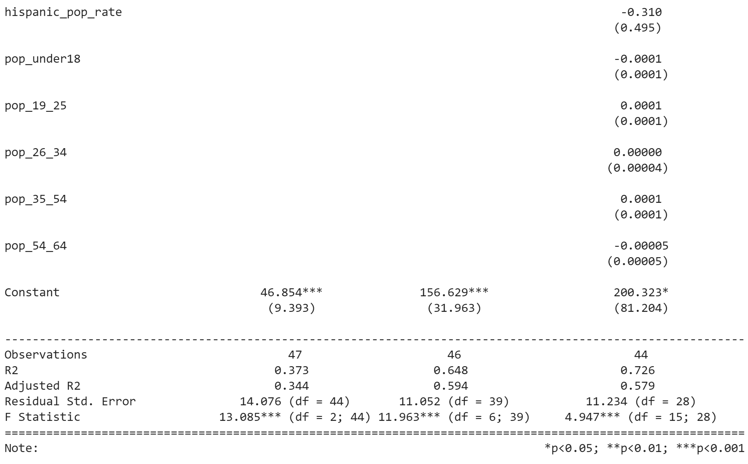
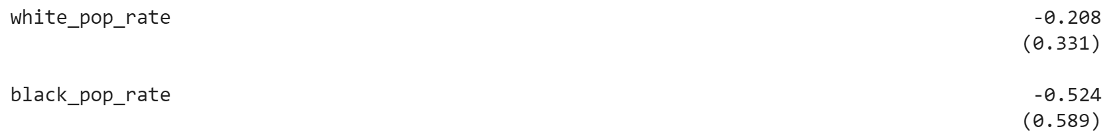
Regression Table
Notes:
First, let us look at the adjusted R^2, we see model 2 has the highest adjusted R^2, and our adjusted R^2 is large enough that means the variables we picked has a strong relationship the outcome variable.
Next we look at our key explanatory variables, we see it loses statistical significance after we control for other causes. Therefore we fail to detect its significance in controlling infection rate. Interestingly other causes like high risk population, pop density, homeless rate remains significant when we overfit the model. This suggest they have a significant relationship with infection rate.
Lastly, we see they all have a negative beta, which is counter intuitive, we will explain why later when we discuss omitted variables.

Slide 7
Limitations of Model & Omitted Variables
CLM Assumptions
Omitted Variables
Assumption
Linear Population Model
IID Sample
Zero conditional mean
No perfect multicollinearity
Homoscedasticity
Normality of errors
Met/Not-Met
Mostly Met
Not Met
Mostly met
Met
Not Met
Mostly Met
Action Taken
Variable transform
Acknowledge in report
Variable transform
N/A
Use Robust Method
Variable transformation
1. Baseline infection rate before policies take place (Positive Bias)
2. Population’s cautiousness with Covid (Negative Bias)

Slide 8
Conclusion
We failed to detect a statistical effect size for mask mandate, even though mask has been scientifically proven to be effective. There are 5 possible reasons that may explain this counter intuitive conclusion.
Wearing mask overamplifies the sense of safety and makes people do things that increase the likelihood of infection
Because we didn't include the baseline infection rate into our model, it is likely that States with higher baseline infection rate also are more likely to have mask mandate. This bias towards zero may have significantly reduced the absolute size of the beta
Because mask mandate sometimes overlap with stay at home order, some of its effect is being included in the beta of stay at home.
With only 50 States and District of Columbia, we don't have enough sample size to detect the effectiveness of mask mandate.
It is difficult to measure the level of adherence to state policies curbing Covid-19 like social distancing, and mask mandate policies. It is difficult to control big crowd behavior as we have seen in various states during protests and beach openings. This is inversely corelated to population density and also inversely correlated to social economic situation (homeless_2019_rate, median_annual_household_income). As a result, the beta coefficients for these features are overestimated. The beta coefficient of percent population susceptible to serious illness (due_covid_serious_ill_rate) is underestimated.

Slide 9
Feature Selection for Research & Modeling
Dependent Variable
Independent variables
OMITTED variables
infection_last_7_rate
stay_at_home
mask_mandate
pop_density
due_covid_serious_ill_rate
homeless_2019_rate
median_annual_household_income
stay_at_home
mask_mandate
pop_density
due_covid_serious_ill_rate
homeless_2019_rate
median_annual_household_income

Slide 10
Causal Theory
Circle with outcome variable (last 14/) – check visual in async
Outcome variable <- Causes
All variables (included in dataset)
Age, health, social-economic factors, population factors, state policies, …, all variables
All variables (not in dataset)
Baseline infection rate (rate before policy), political bias and beliefs,

Slide 11
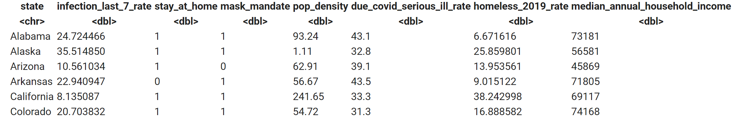
Exploratory Data Analysis Process

Slide 12
Omitted Variables
(Include correlation and bias info)
Omitted variable: infection rate before policies take place
Omitted variable: % of the population whose belief that personal liberty is more important than health

